Slide 1
IFRS 17 - SunRise
Facilitator:
Aditya Kumar
Aditya Sahu

Slide 2
Agenda
What is IFRS 17
Why IFRS 17 needed
What is SunRise
Basic Terminology
Types of Approaches for ETL solution
Sunrise Architecture
Tools and Technology Stack
High Level ETL Architecture
Q & A

Slide 3
What is IFRS 17
IFRS stands for International Financial Reporting Standards
Issued by International Accounting Standards Board(IASB)
IASB is a governing body which issues standards related to Insurance, Financial Instruments etc.
IFRS 17 is a reporting standard applied on insurance contracts.
This standard will apply globally on every insurance company.
It will replace the existing standard for insurance contracts i.e IFRS 4.
The changes will reflect in Balance sheet, Income statement, Disclosures etc, therefore making this project highly visible.

Slide 4
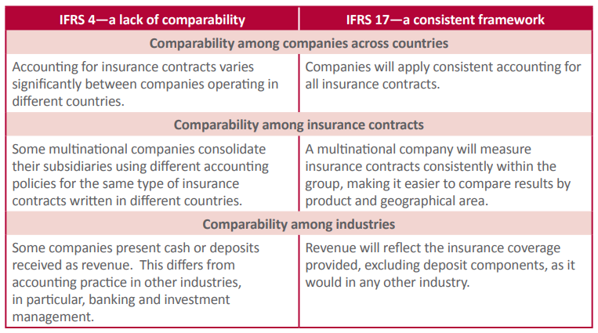
Why IFRS 17 needed
To bring consistency to financial reporting around the globe for companies reporting under IFRS 17, and to better compare those insurance companies to those operating in other sectors of industry

Slide 5
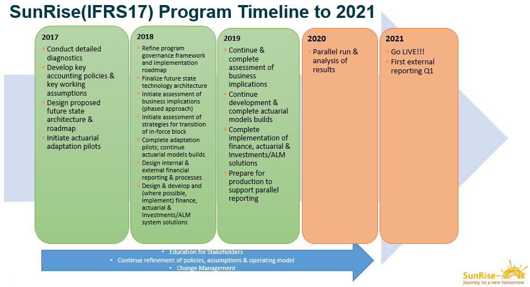
What is SunRise
SunRise is an in-house project to implement the IFRS 17 standards in Sun Life.

Slide 6
Basic Terminology
Actuary: An actuary is a professional who assesses and manages the risks of financial investments, insurance policies and other potentially risky ventures.
Model AXIS: Its an actuarial modelling solution and SLF’s main valuation software that provides complete integration of pricing, valuation and modelling.
Data Standardization: To bring similar type of data on common standard. For ex: Policy Administration Systems (PAS) may encode the same data item in a number of different ways. Gender may be encoded as Male/Female, M/F or 0/1 etc. in different systems.
Accounting Hub: A data store to store the granular finance data for downstream reporting and analysis.
CSM: Contractual Service Margin(CSM) is a component of asset or liability for the group of insurance contracts that represents the unearned profit the entity will recognize as it provides services in the future.
Ledger: A ledger is a collection of financial accounts. It records classified and summarized financial information.

Slide 7
How we are approaching for ETL solution
Options | Level of Standardization
Option 1 | No data standardization; use existing feeds and ETL and create supplementary feeds if required
Option 2 | Minimal data standardization to support implementation of a Standardization Layer (SL) and Actuarial Data Repository (ADR)
Option 3 | Redevelop and Standardize ETLs and cleaning up the DataLink to move the pure transformation logic out of DL and into the ETL

Slide 8
SunRise Architecture
On Premises
Cloud Infrastructure
Component | Description
Data Standardization | Standardizes actuarial snapshot data and produce Policy Information Tables and other model inputs to feed into actuarial models and into the actuarial database
Model | Actuarial calculators (AXIS, PathWise, etc.)
Assumptions | Actuarial assumptions (such as mortality assumptions) that are inputs into actuarial models
Actuarial Repository | Database to store all actuarial data, including model outputs and PAS (policy admin systems) data post-standardization, or support reporting and analysis
Rules Engine | Part of the Aptitude Accounting Hub to take in data from PAS and feed into appropriate accounts in the Accounting Hub
Accounting Hub | A finance data store that acts as a sub-ledger to store granular finance data to support downstream reporting and analysis
General Ledger | A ledger to store aggregated finance data for disclosures
Disclosure | A platform/system to produce all mandatory external financial statements
Narrative | A platform to generate the narrative to explain financial results
Investments Data Repository* | Database to store all investments data
Basis Setting | A platform to perform analysis for actuarial basis assumptions
Discount Rate | A system/tool to develop discount rates that feeds models
Investments Results Explanation | A platform to perform analysis for performance attribution of investments
CSM | A calculation engine to produce IFRS17 measures such as CSM, LC, and other calculated measures that are required for financial reporting
Reporting & Analysis Platform | A platform that pulls data from actuarial, finance, and investments databases and prepares data to support reporting and analysis
Analysis Outputs | Applications (such as analysis of income statement and reserve movement analysis) that support internal reporting and MI analysis
Control Framework | A set of control points to track the quality/completeness and timeliness of data as it moves through the architecture
Data Sources
Verify / Standardize
Calculate
Analysis / DA
Reporting & Disclosure
Basis Setting
Investment Results Explanation
Analysis Outputs
Data Sources:
Assets
Policy
Reinsurance
Discount Rate
Investments Data Repository*
Assumptions
Reporting & Analysis Platform
Data Standardization
Models
Snapshot Data
Policy Data
Reserve
Info & ALM
Actuarial Repository
Narrative
Reserves
Disclosure
Aptitude Rules Engine
CSM
Insurance and Investment Accounting
Reserve Accounting
Aptitude Sub Ledger
Aggregated
General
Ledger
Planning System
Version 2.2 (May 20, 2019)
Control Framework
Financial Reporting
& Disclosures
ALM / Investments
Actuarial
Cross - Streams
CSM Engine and Sub Ledger: Risk Integrity (RI)
Not within SunRise scope

Slide 9













Tools and Technology: Actuarial Workstream Dev
Programming Language:
ETL Tools and IDE:
Computing Engine:
Version Control:
AWS Services:
AWS Glue
S3
EC2
Redshift
RDS
Cloud Formation
Step Function

Slide 10
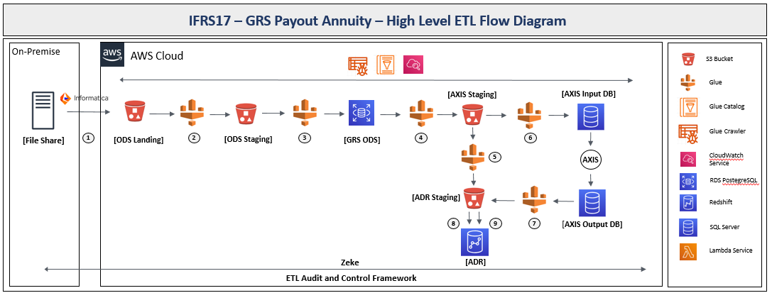
High Level ETL Architecture

Slide 11
SunRise Architecture
On Premises
Cloud Infrastructure
Data Sources
Verify / Standardize
Calculate
Analysis / DA
Reporting & Disclosure
Basis Setting
Investment Results Explanation
Analysis Outputs
Data Sources:
Assets
Policy
Reinsurance
Discount Rate
Investments Data Repository*
Assumptions
Reporting & Analysis Platform
Data Standardization
Models
Snapshot Data
Policy Data
Reserve
Info & ALM
Actuarial Repository
Narrative
Reserves
Disclosure
Aptitude Rules Engine
CSM
Insurance and Investment Accounting
Reserve Accounting
Aptitude Sub Ledger
Aggregated
General
Ledger
Planning System
Version 2.2 (May 20, 2019)
Control Framework
Financial Reporting
& Disclosures
ALM / Investments
Actuarial
Cross - Streams
CSM Engine and Sub Ledger: Risk Integrity (RI)
Not within SunRise scope

Slide 12




